Slide 1





WHO WANTS TO BE A MILLIONAIRE?

Slide 2




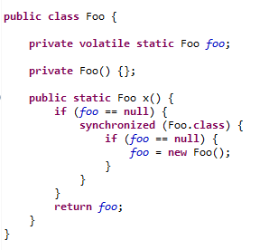
THE FOLLOWING CODE IS …
1/6
Eager Singleton
Double-Checked Locking Singleton
Bill Pugh’s Solution Singletion
Singleton initialized in a static block
Enum Singleton
Incorrect implementation of Singleton
Abstract Factory
Incorrect implementation of Abstract Factory
Composite
Incorrect implementation of Composite

Slide 3
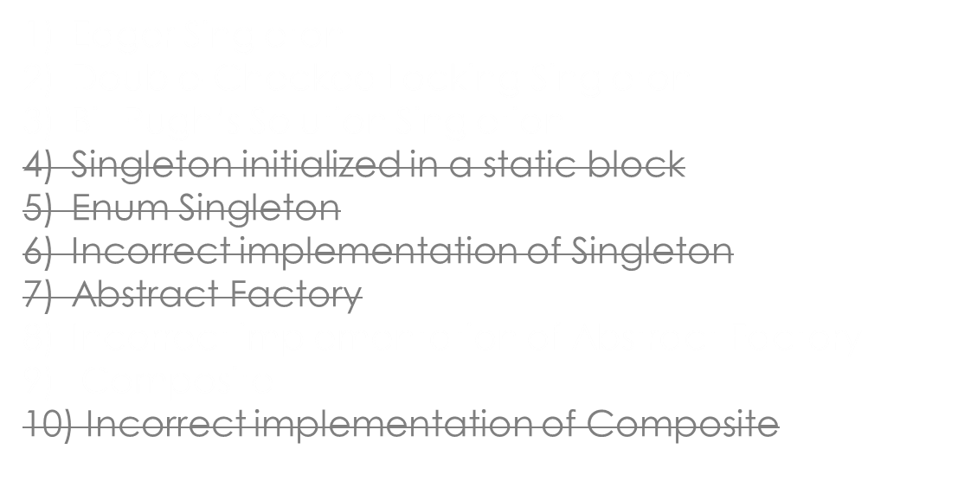

THE FOLLOWING CODE IS …
1/6

Slide 4
THE FOLLOWING CODE IS …
1/6
Eager Singleton
Double-Checked Locking Singleton
Bill Pugh’s Solution Singletion
Singleton initialized in a static block
Enum Singleton
Incorrect implementation of Singleton
Abstract Factory
Incorrect implementation of Abstract Factory
Composite
Incorrect implementation of Composite

Slide 5
WHICH ONE OF THE FOLLOWING IS NOT A PARTICIPANT IN ABSTRACT FACTORY PATTERN? (SELECT ALL THAT APPLY)
2/6
Abstract Factory
Concrete Factory
Abstract Product
Concrete Product
Abstract Creator

Slide 6
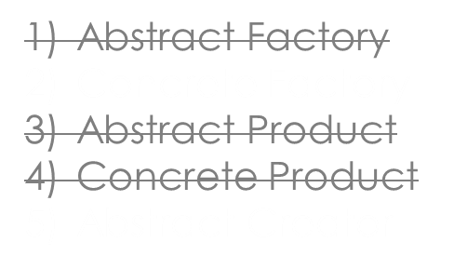
WHICH ONE OF THE FOLLOWING IS NOT A PARTICIPANT IN ABSTRACT FACTORY PATTERN? (SELECT ALL THAT APPLY)
2/6

Slide 7
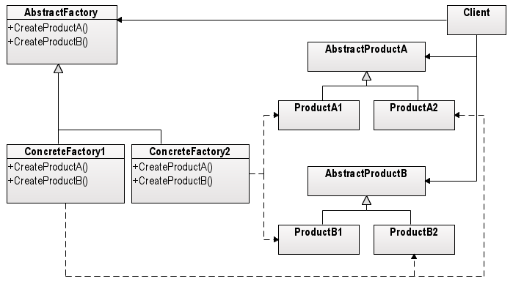
WHICH ONE OF THE FOLLOWING IS NOT A PARTICIPANT IN ABSTRACT FACTORY PATTERN? (SELECT ALL THAT APPLY)
2/6
Abstract Factory
Concrete Factory
Abstract Product
Concrete Product
Abstract Creator

Slide 8
WHAT IS VALID FOR THE ABSTRACT FACTORY (ITSELF)? (SELECT 4 THAT APPLY)
3/6
Provides an interface for creating families of related or dependent objects without specifying their concrete classes.
Provides an interface for creating families of related or dependent objects with specifying their concrete classes.
The abstract factory pattern is used to provide a client with a set of related or dependant objects. The "family" of objects created by the factory are determined at compile time.
The abstract factory pattern is used to provide a client with a set of related or dependant objects. The "family" of objects created by the factory are determined at run-time.
The Abstract Factory pattern is one level of abstraction higher than the Factory Method pattern.
The Abstract Factory pattern is one level of abstraction lower than the Factory Method pattern.
One classic application of the Abstract Factory pattern is when your system needs to support multiple look-and-feel user interfaces.
Application of the Abstract Factory pattern in order to support multiple look-and-feel user interfaces is inappropriate.

Slide 9

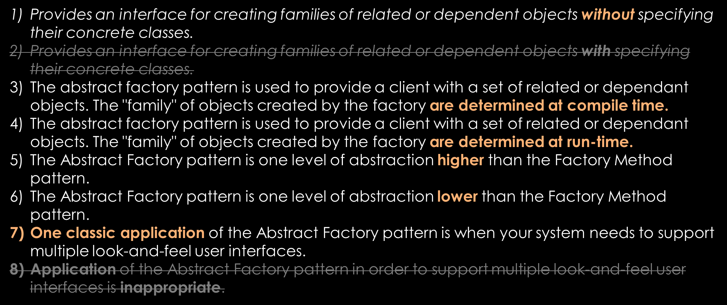
WHAT IS VALID FOR THE ABSTRACT FACTORY (ITSELF)? (SELECT 4 THAT APPLY)
3/6

Slide 10
WHAT IS VALID FOR THE ABSTRACT FACTORY (ITSELF)? (SELECT 4 THAT APPLY)
3/6
Provides an interface for creating families of related or dependent objects without specifying their concrete classes.
Provides an interface for creating families of related or dependent objects with specifying their concrete classes.
The abstract factory pattern is used to provide a client with a set of related or dependant objects. The "family" of objects created by the factory are determined at compile time.
The abstract factory pattern is used to provide a client with a set of related or dependant objects. The "family" of objects created by the factory are determined at run-time.
The Abstract Factory pattern is one level of abstraction higher than the Factory Method pattern.
The Abstract Factory pattern is one level of abstraction lower than the Factory Method pattern.
One classic application of the Abstract Factory pattern is when your system needs to support multiple look-and-feel user interfaces.
Application of the Abstract Factory pattern in order to support multiple look-and-feel user interfaces is inappropriate.

Slide 11
TO WHICH CATEGORY DOES COMPOSITE PATTERN BELONG?
4/6
1. Behavioral
2. Creational
3. Structural
4. Functional

Slide 12
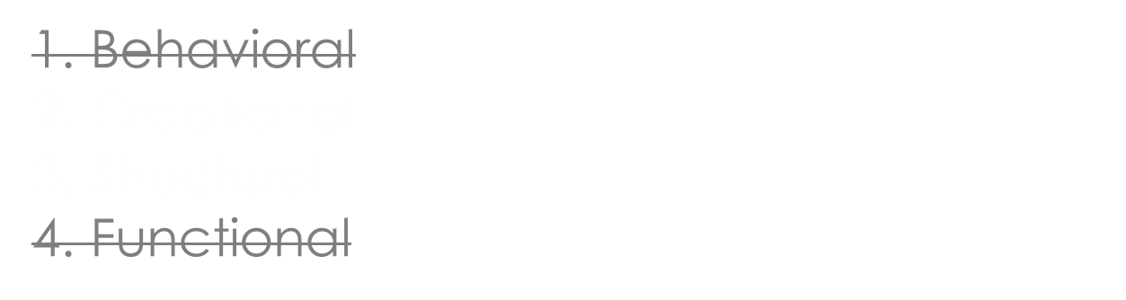

TO WHICH CATEGORY DOES COMPOSITE PATTERN BELONG?
4/6

Slide 13
TO WHICH CATEGORY DOES COMPOSITE PATTERN BELONG?
4/6
1. Behavioral
2. Creational
3. Structural
4. Functional

Slide 14
WHICH OPERATION IS NOT MANDATORY TO BE IMPLEMENTED IN A
COMPOSITE ACCORDING TO GOF DEFINITION?
5/6
1. GetChild
2. GetParent
3. Add
4. Remove

Slide 15
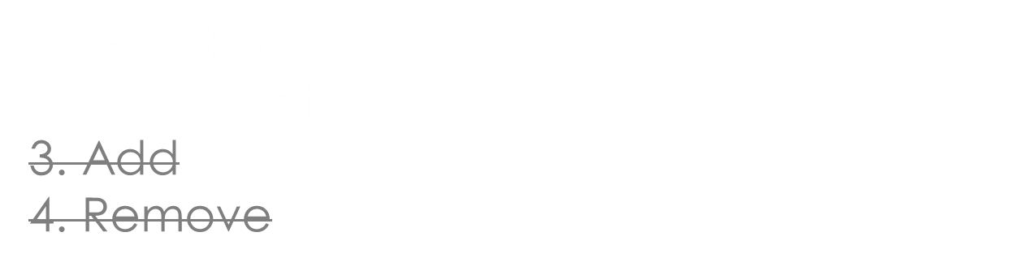
WHICH OPERATION IS NOT MANDATORY TO BE IMPLEMENTED IN A
COMPOSITE ACCORDING TO GOF DEFINITION?
5/6

Slide 16
WHICH OPERATION IS NOT MANDATORY TO BE IMPLEMENTED IN A
COMPOSITE ACCORDING TO GOF DEFINITION?
5/6
1. GetChild
2. GetParent
3. Add
4. Remove

Slide 17
WHICH OF THE FOLLOWING IS NOT A FITTING USE CASE FOR COMPOSITE?
6/6
1. Painting application (ellipsis, square, snowman)
2. Employee registry (e.g. bluepages - employee, manager)
3. Module for reading different table processing files (xls, xlsx, ods...)
4. Investment asset mapping (shares, account, cash, property...)

Slide 18
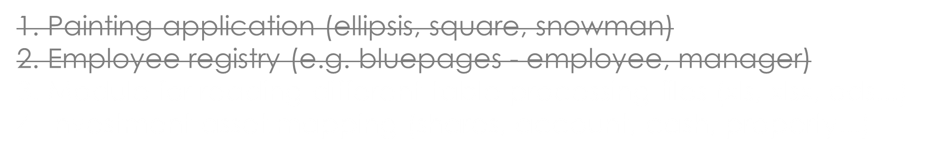

WHICH OF THE FOLLOWING IS NOT A FITTING USE CASE FOR COMPOSITE?
6/6

Slide 19
WHICH OF THE FOLLOWING IS NOT A FITTING USE CASE FOR COMPOSITE?
6/6
1. Painting application (ellipsis, square, snowman)
2. Employee registry (e.g. bluepages - employee, manager)
3. Module for reading different table processing files (xls, xlsx, ods...)
4. Investment asset mapping (shares, account, cash, property...)

